Slide 1













J.B.INSTITUTE OF ENGINEERING AND TECHNOLOGY
(UGC AUTONOMOUS)
Accredited by NAAC & NBA, Approved by AICTE & Permanently Affiliated to JNTUH
Organized by

Slide 2


TEAM DETAILS
1
Selected Track - Health Care and Improvements
2
Problem Statement Title – Creating a Website To Give Health
Improvement Tips and Gives a Detail Report
3
Team Name - Tech Army
4
Team Lead - Abdul Raheem
5
Dept. Name - AI&ML ( CSM)

Slide 3

Wellness Web
Proposed Solution:
Our Idea is to Devolop a Smart health care monitoring Website
Our Website Helps to give you Health Tips and Improvements of Your Health and Gives a clarification of a Health Reports.

Slide 4
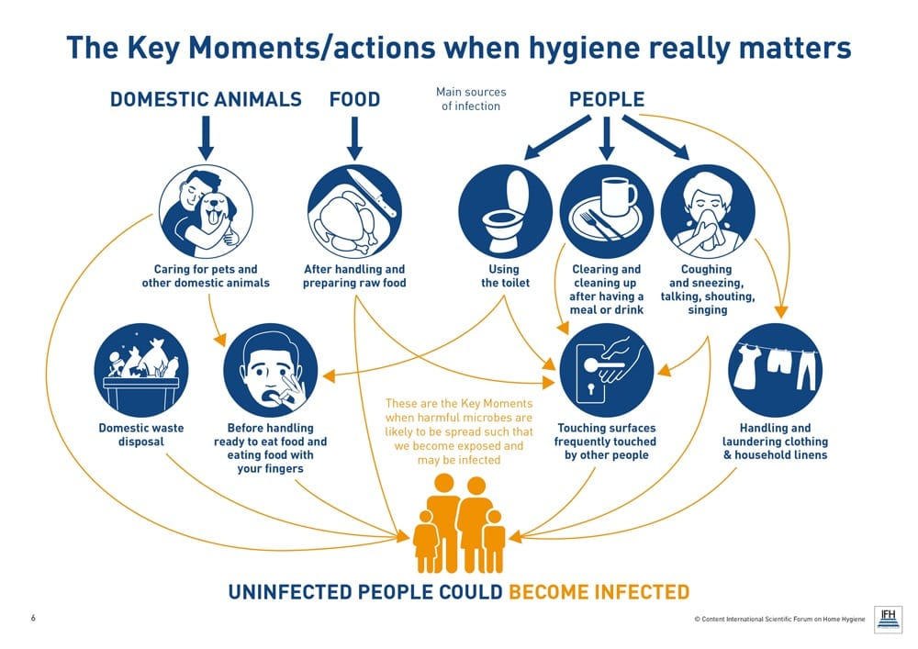
TECHNICAL APPROACH
Excreta management systems
Waste water management systems
Safe water provisions
Hygienic designs
Cleaning protocols and equipments
Hand washing facilities
Health apps

Slide 5
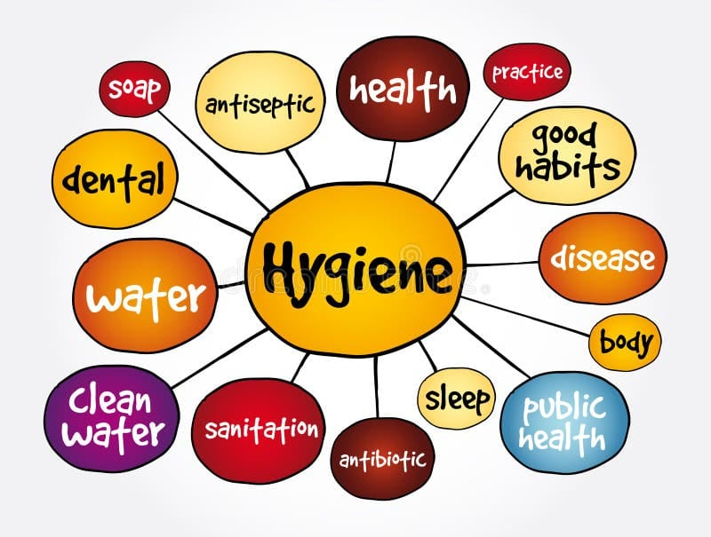

Slide 6
FEASIBILITY AND VIABILITY
The System Provides a Socially beneficial impact by helping people understand their Health Condition in simple language.
It supports early diagnosis, promotes health awareness and bridges the gap between doctors and patients This aligns with the goals of improving healthcare accessibility and awareness in society

Slide 7
IMPACT AND BENEFITS
The Website gives you how to take care of your Health and Tells a tips to manage your Health.
This also tells us what diseases comes to a Person when he is Unhygenic

Slide 8


Slide 9

IMPACTS ON BODY

Slide 10
Team Member’s Information
Team Leader Name: Abdul Raheem
Year: 2nd Department: AI&ML(CSM) Roll Number: 25675A6605
Team Member 1 Name: B. Samuel . Steven
Year: 2nd Department: AI&ML(CSM) Roll Number: 25675A6606
Team Member 2 Name: B . Naresh
Year: 2nd Department: AI&ML(CSM) Roll Number: 25675A6603

Slide 11
THANK YOU

